Slide 1
Exercise for 5 days
Task A . COMM2700 . W0441213 . Jamie Lu

Slide 2
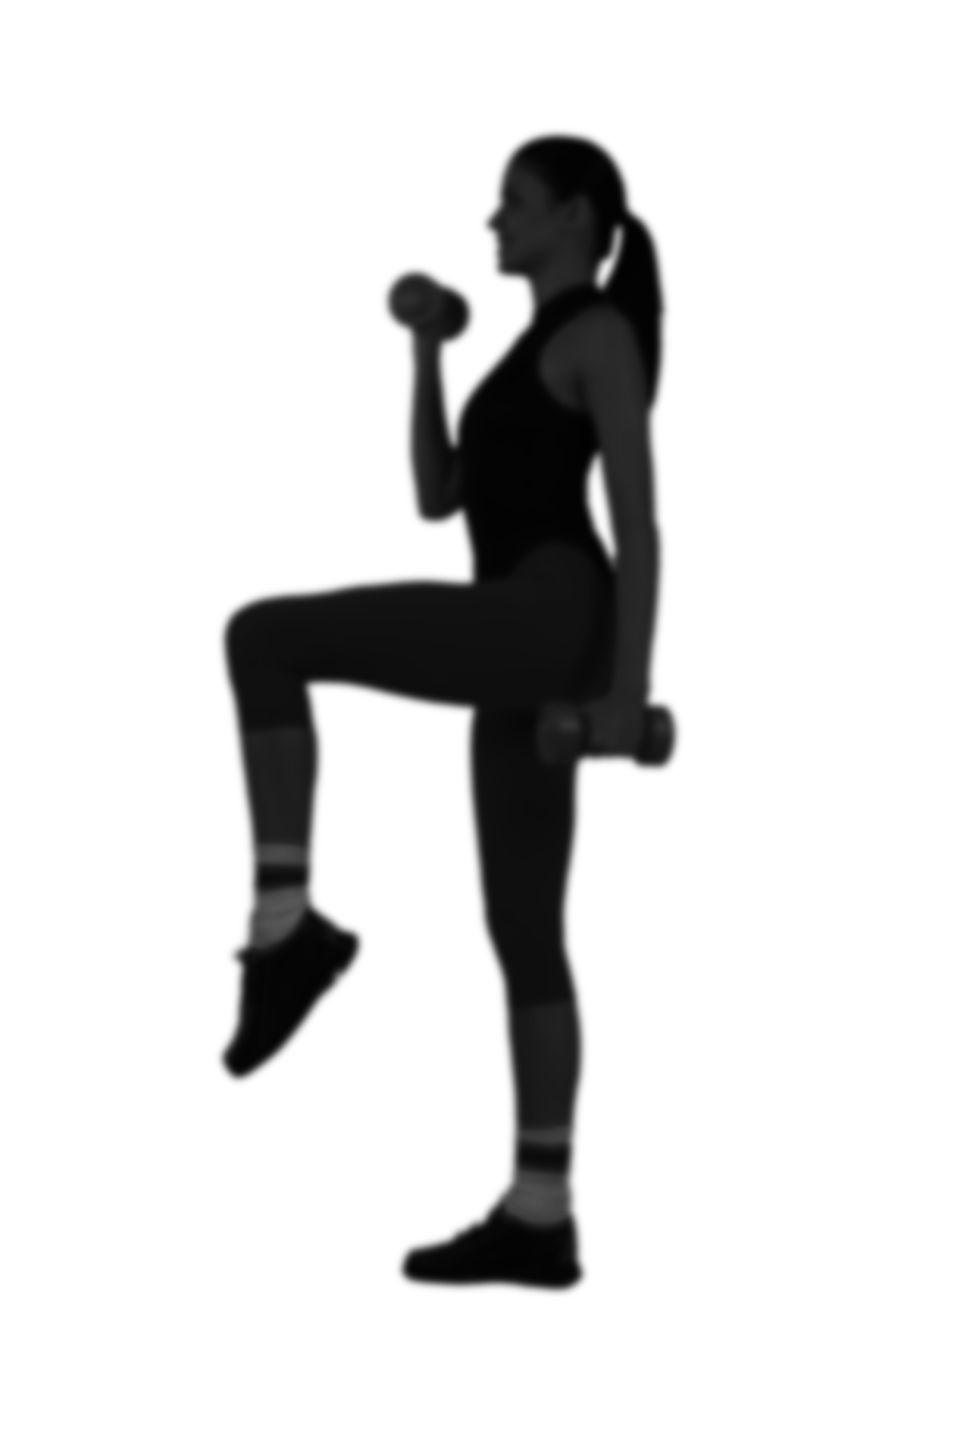
Introduction
Exercise is very crucial to every human being’s health. It can not only help physically but emotionally and mentally as well.
Last year, I took on the challenge of exercising as my project. I really saw the impact that took on my life and that is why I would like to motivate myself again using this task.
This Photo by Unknown Author is licensed under CC BY-NC

Slide 3
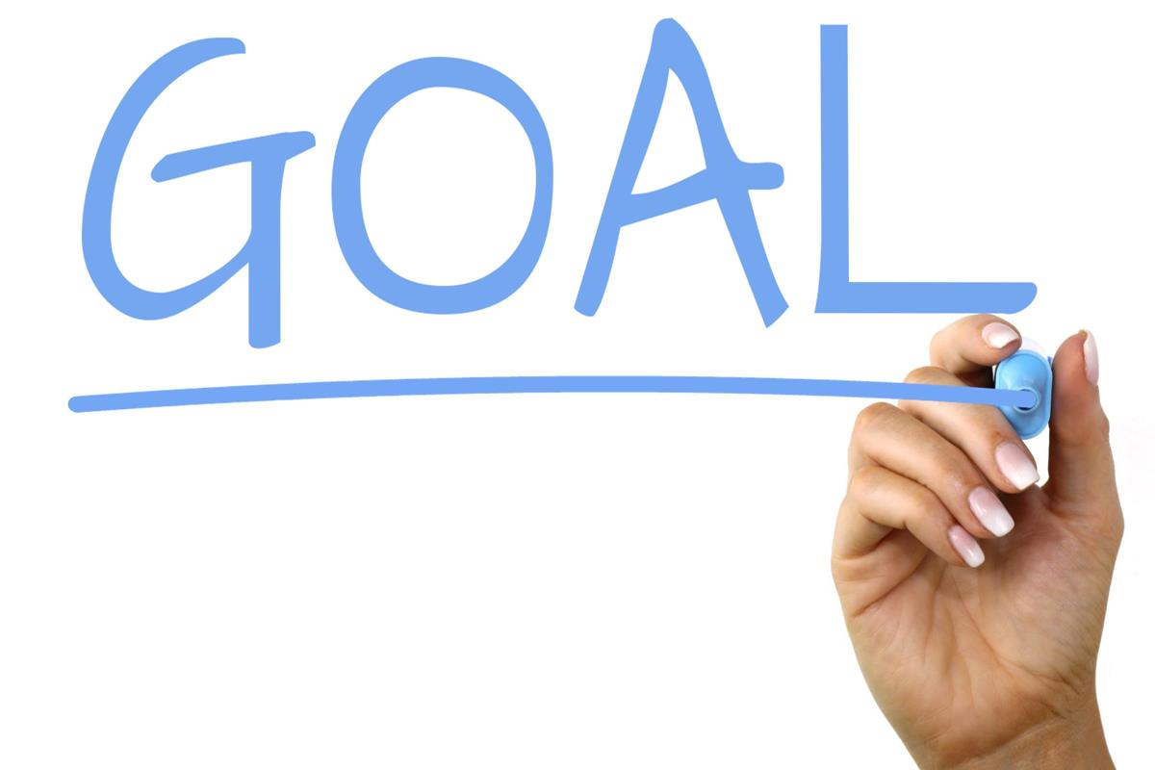
Do the planned exercises everyday for a week!
This Photo by Unknown Author is licensed under CC BY-SA

Slide 4
Directions
Healthy Habit Tracker
When the day is complete, the corresponding circle will be filled indicating that I have completed my goal for that day.

Slide 5
Healthy Habit Tracker
Drink 32 oz of water
Jumping Jacks
10counts 3 reps
Squats
10counts 3 reps
M T W T F S S
M T W T F S S
M T W T F S S
Sit ups
10counts 3 reps
Jumping Jacks
10counts 3 reps
Leg Raises
10counts 3 reps
M T W T F S S
M T W T F S S
M T W T F S S

Slide 6

Results
I have successfully followed the scheduled exercises as well as drank at least 32oz of water each day. I feel a lot lighter and healthier. This task has successfully motivated me to do exercises everyday in order to maintain a healthier lifestyle.

